Slide 1
Module 05 – Forms and Data Storage
By Darice Corey-Gilbert

Slide 2
Housekeeping
Module 6 begins on Monday, 6/11
The course ends on Friday, 6/15.
Module 6 assignments are due on Sunday, 6/17

Slide 3
Form Styles and Basic Form
When you create forms on your site, it is important that they are responsive. It can be very frustrating when users open a web page using a mobile device or tablet and they are forced to pinch and zoom to navigate to different sections of a form.
By default, Bootstrap predefines styling of forms using the class .form-control.
All textual elements (input, textarea, and select) have a 100% width.
Bootstrap offers three types of form layouts: vertical, horizontal, and inline.

Slide 4


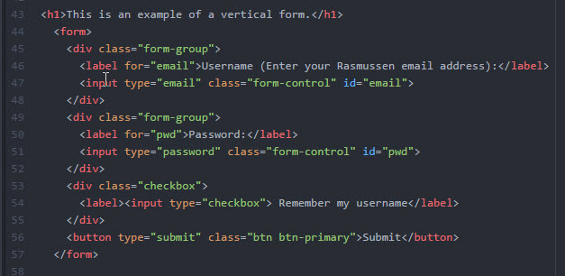


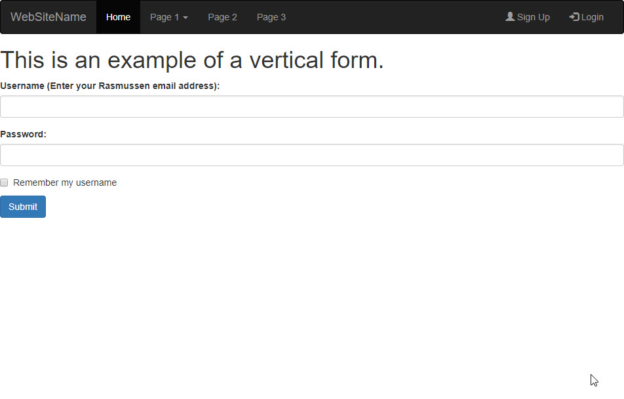

Vertical Form - Mod5_ex1.html illustrates an example of a vertical form.

Slide 5
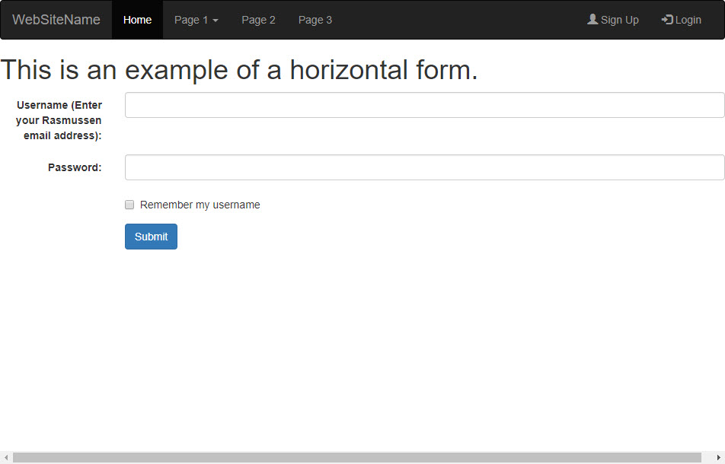
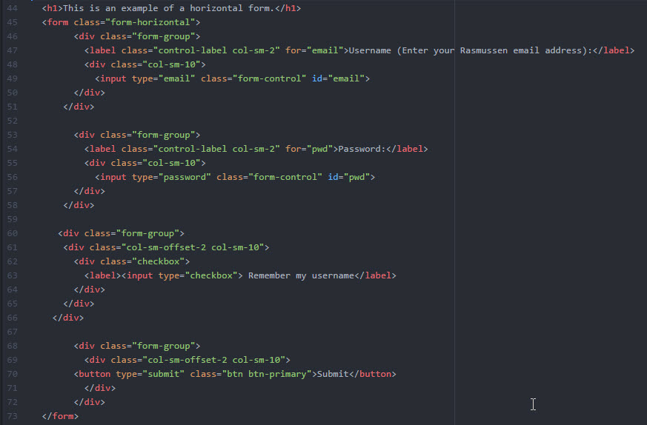
Horizontal Form - Mod5_ex2.html illustrates an example of a horizontal form.

Slide 6
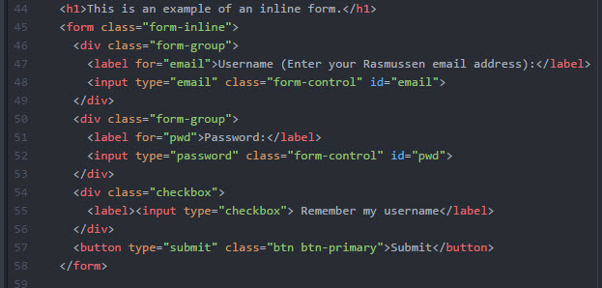
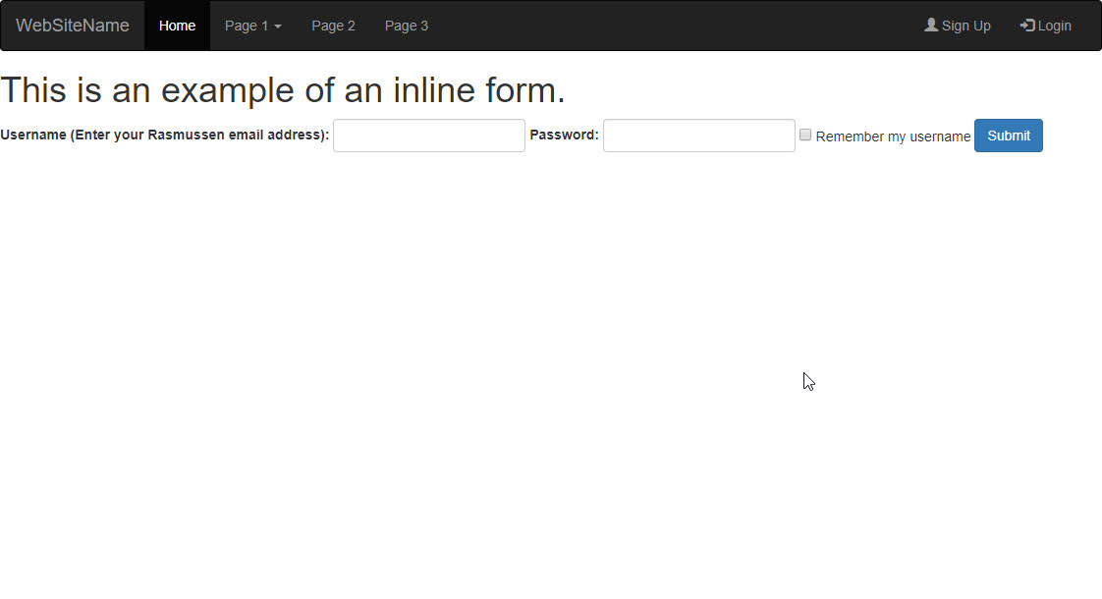
Inline Form - Mod5_ex3.html illustrates an example of an inline form.

Slide 7
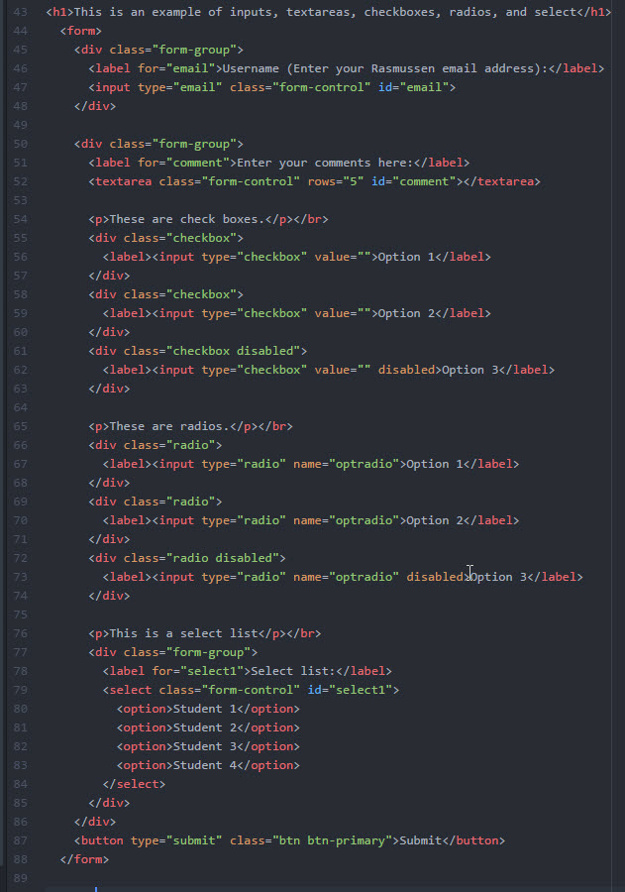
Inputs, Checkboxes, and Radios
Bootstrap also predefines styling for other form elements, such as text or input boxes, textareas, checkboxes, radios, or selects.
Mod5_ex4.html illustrates examples of these.

Slide 8
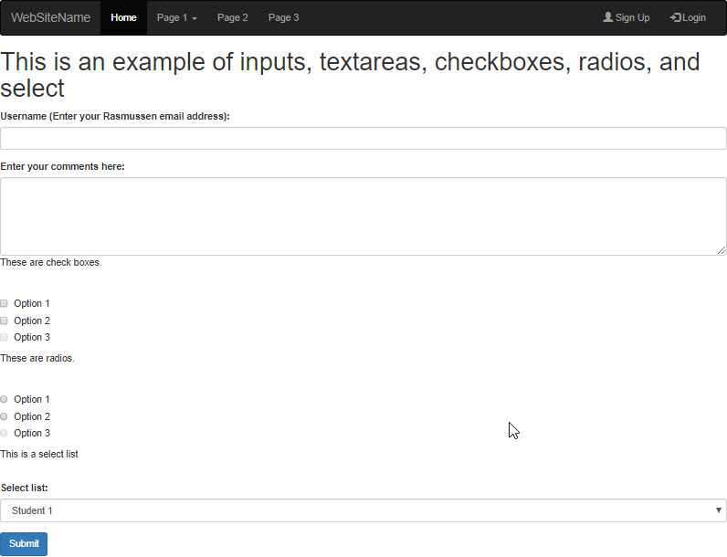
Inputs, Checkboxes, and Radios
Bootstrap also predefines styling for other form elements, such as text or input boxes, textareas, checkboxes, radios, or selects.
Mod5_ex4.html illustrates examples of these.

Slide 9
Form Validation
When form validation is used, you will be less likely to collect input from users that contains data that cannot be used or mistakenly entered.
In Bootstrap, HTML form validation is applied using pseudo-classes in CSS, :invalid and :valid.
These classes can be applied to input, select, and textarea elements.
Mod5_ex5.html illustrates an example which will display a popup message if a form field is left blank and the user attempts to click submit.

Slide 10
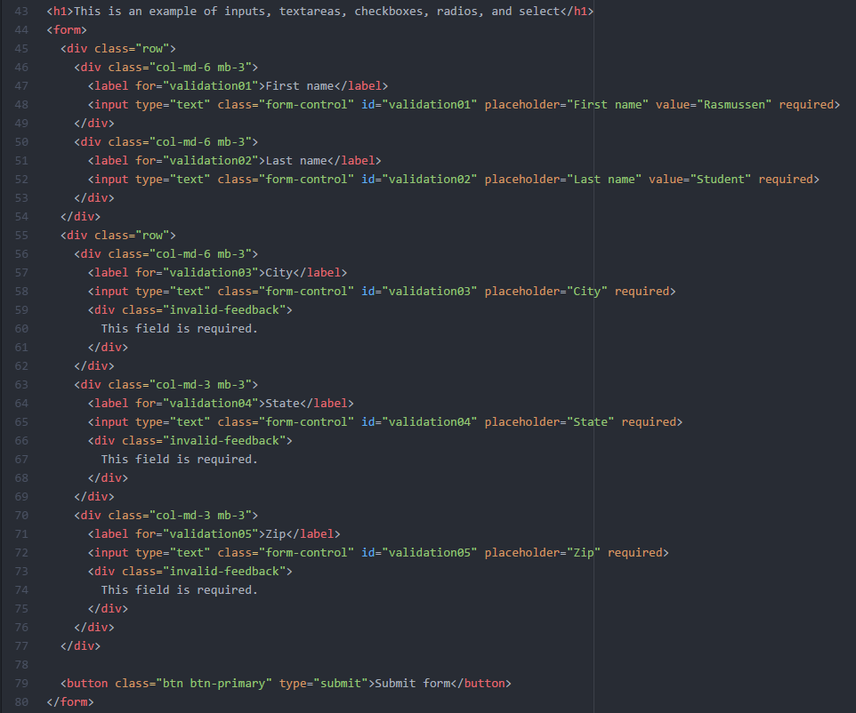
Form Validation
Mod5_ex5.html illustrates an example which will display a popup message if a form field is left blank and the user attempts to click submit.

Slide 11
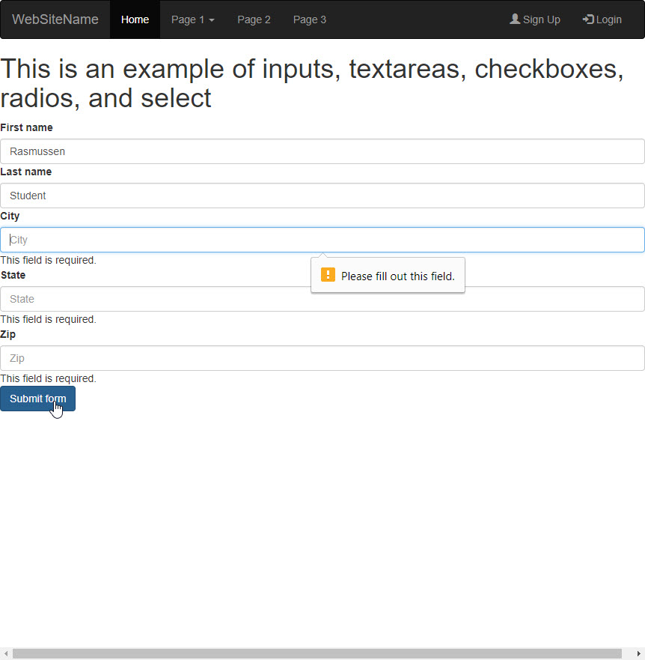
Form Validation
Mod5_ex5.html illustrates an example which will display a popup message if a form field is left blank and the user attempts to click submit.

Slide 12
Data and Storage API
There may be times when you will need your web application to store data locally within the user’s browser.
Local data storage, now available in HTML5 using the Web Storage API, can now replace cookies.
This method is more secure, and can store larger amounts of data without affecting website performance.

Slide 13
Data and Storage API
There are two objects that store data on the client:
window.localStorage
window.sessionStorage.
window.localStorage stores data even after the browser is closed.
Window.sessionStorage stores data for only one session and is cleared once the browser tab is closed. The data is always stored as strings and requires conversion to other formats, as needed.

Slide 14
Data and Storage API
Web storage uses three interfaces:
Storage allows you to set, retrieve, or delete data.
Window provides access to the session and local objects.
A storage event is executed on an object with the storage area changes.

Slide 15
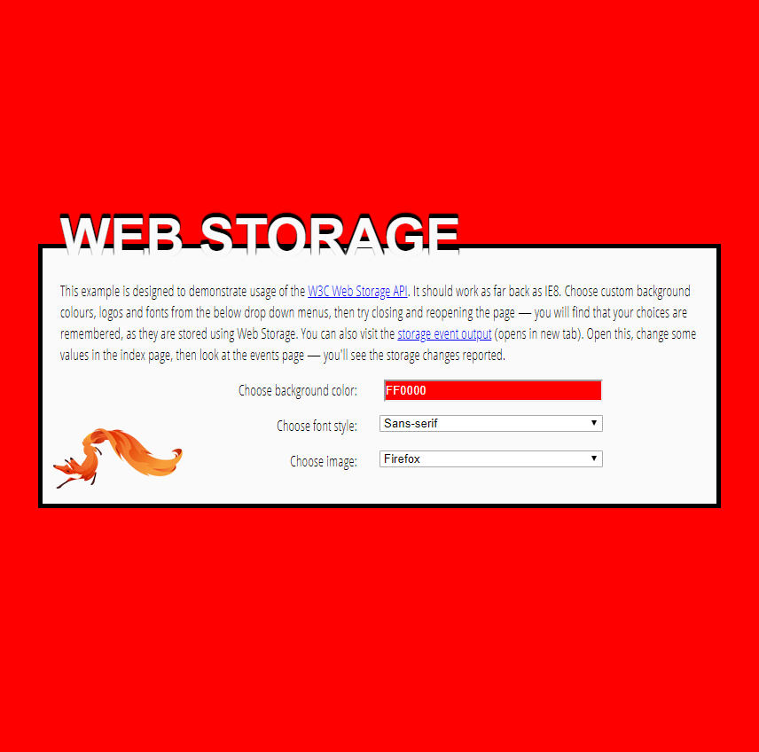
Data and Storage API
Some examples of the web storage API in use are sites that allow the user to save background colors, or a user’s first name for a welcome message.
Mozilla Developer Network provides a helpful example here.

Slide 16
Data and Storage API
Mozilla Developer Network provides a helpful example here.
The user can instantly customize the color, font, and image on the page.
If you close your browser tab, and reload the page again, the color, image, and font style you selected should remain, because your selections are stored in local storage.

Slide 17
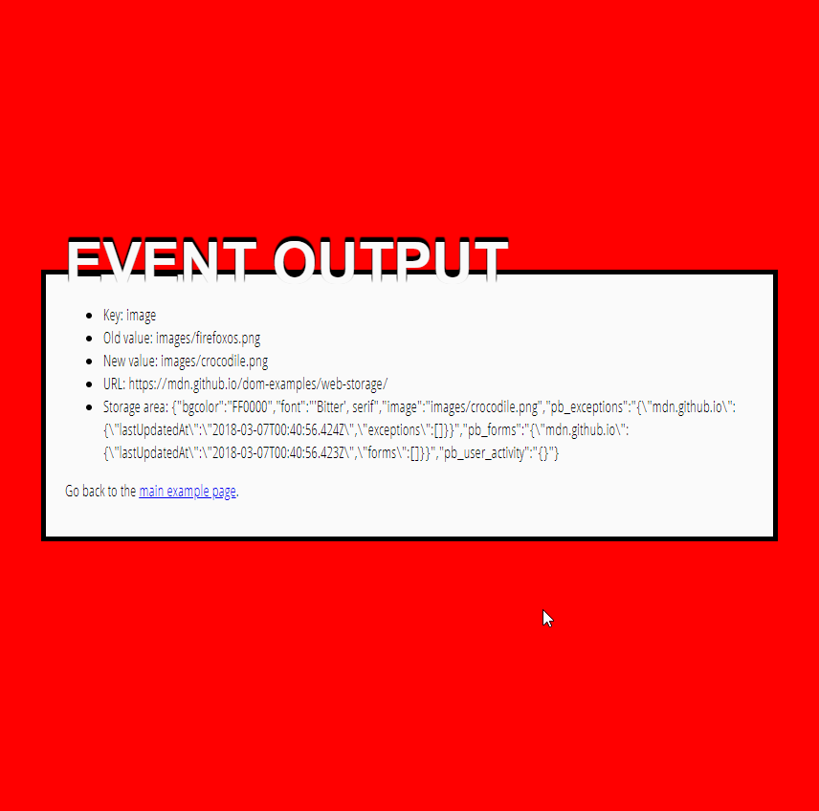
Data and Storage API
Another example here illustrates your selections.
If you make changes to the previous page and refresh this one, you’ll notice that the storage information has been updated.

Slide 18
Module 05 Activity – Data Models
In this module, we discussed the Web Storage API, used to store and retrieve data.
There are additional technologies, such as Web SQL Database, Indexed Database, and File Access, which can also be used to store data.
Research Web SQL Database, Indexed Database, and File Access, and write a 3-page paper explaining how each can be used.
In your paper, provide examples of data models for each technology.

Slide 19
Module 05 Course Project – Adding Forms
Create one new page in your site that contains a form. Your form must use the Bootstrap framework and styling. Your form must have:
At least 2 text boxes
At least 1 text area
At least 1 set of check boxes
At least 1 set of radios
At least one dropdown with 3 options
A submit button
The form must have form validation to disallow submission when the submit button is clicked.
The form does not require an action, since form processors were not covered in this course.

Slide 20
Module 05 Course Project – Adding Forms
Your submission must include the following:
A Microsoft Word Document containing the URL to your revised pages uploaded to your Rasmussen SOTD site. For example: http://sotd.us/[your account name]/CIS4655/projects/module5.html
The Microsoft Word document must also contain screen shots that illustrate 5-6 previews of your page, in portrait and landscape orientation, using Chrome Developer Tools. For example, Galaxy S5, iPhone 6, and iPad Pro. The navigation should be clearly visible in your screen shots.
Screenshots should also show form validation.
A ZIP file containing your Module 05 Course Project assignment

Slide 21
Live Lecture Keyword
…

